Slide 1

Parameterized Inapproximability Hypothesis under ETH
Venkatesan Guruswami Bingkai Lin Xuandi Ren Yican Sun Kewen Wu

Slide 2

Outline
Parameterized Complexity
  Parameterized Inapproximability Hypothesis
Our Result: ETH $⇒$ PIH
Proof Sketch
  Vector-Valued CSP
  3SAT$→$VecCSP
  Parallel PCP of Proximity

Slide 3




Parameterized Complexity
An input instance $x$ is associated with a parameter $k∈ℕ$
Complexity is measured as a function of both $n=|x|$ and $k$.
FPT (Fixed-Parameter Tractable):
  problems that admit $f(k)∙n^{O(1)}$ time algorithms, $f$ can be any computable function
$k$-Vertex Cover
Input:
  $G=\left(V,E\right)$
Output:
  $∃v_{1},…, v_{k}∈V$ covering all the edges?
has a $2^{k}∙n^{O(1)}$ enumeration algorithm
$$∈$$
FPT

Slide 4


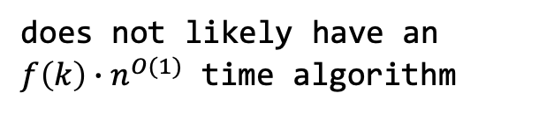
Parameterized Complexity
An input instance $x$ is associated with a parameter $k∈ℕ$
Complexity is measured as a function of both $n=|x|$ and $k$.
FPT (Fixed-Parameter Tractable):
  problems that admit $f(k)∙n^{O(1)}$ time algorithms, $f$ can be any computable function
$k$-Independent Set
Input:
  $G=\left(V,E\right)$
Output:
  $∃v_{1},…, v_{k}∈V$ which form an independent set?
does not likely have an
$f\left(k\right)∙n^{O(1)}$ time algorithm
W[1]
-complete

Slide 5



Parameterized Complexity
An input instance $x$ is associated with a parameter $k∈ℕ$
Complexity is measured as a function of both $n=|x|$ and $k$.
FPT (Fixed-Parameter Tractable):
  problems that admit $f(k)∙n^{O(1)}$ time algorithms, $f$ can be any computable function
$k$-Vertex Cover
Input:
  $G=\left(V,E\right)$
Output:
  $∃v_{1},…, v_{k}∈V$ covering all the edges?
$k$-Independent Set
Input:
  $G=\left(V,E\right)$
Output:
  $∃v_{1},…, v_{k}∈V$ which form an independent set?
FPT
$$⊆$$
W[1]

Slide 6
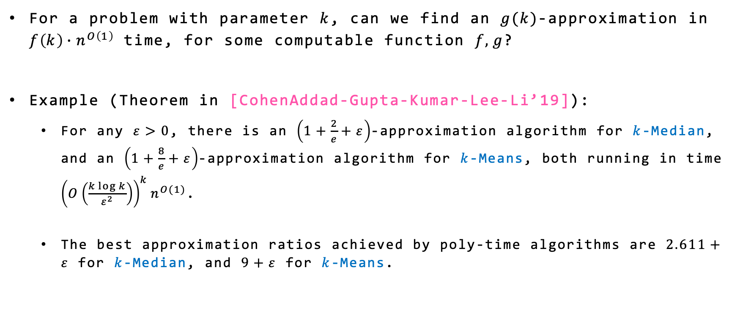
Parameterized Approximation
For a problem with parameter $k$, can we find an $g(k)$-approximation in $f\left(k\right){∙n}^{O\left(1\right)}$ time, for some computable function $f,g$?
Example (Theorem in [CohenAddad-Gupta-Kumar-Lee-Li’19]):
  For any $ε>0$, there is an $\left(1+\frac{2}{e}+ε\right)$-approximation algorithm for $k$-Median, and an $\left(1+\frac{8}{e}+ε\right)$-approximation algorithm for $k$-Means, both running in time ${\left(O\left(\frac{k\log{k}}{ε^{2}}\right)\right)}^{k}n^{O(1)}$.
  The best approximation ratios achieved by poly-time algorithms are $2.611+ε$ for $k$-Median, and $9+ε$ for $k$-Means.

Slide 7
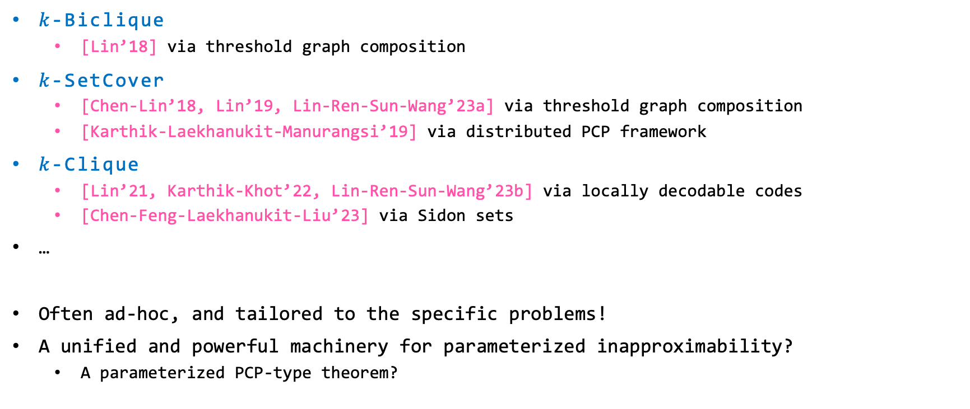
Parameterized Hardness of Approximation
$k$-Biclique
  [Lin’18] via threshold graph composition
$k$-SetCover
  [Chen-Lin’18, Lin’19, Lin-Ren-Sun-Wang’23a] via threshold graph composition
  [Karthik-Laekhanukit-Manurangsi’19] via distributed PCP framework
$k$-Clique
  [Lin’21, Karthik-Khot’22, Lin-Ren-Sun-Wang’23b] via locally decodable codes
  [Chen-Feng-Laekhanukit-Liu’23] via Sidon sets
…
Often ad-hoc, and tailored to the specific problems!
A unified and powerful machinery for parameterized inapproximability?
  A parameterized PCP-type theorem?

Slide 8



Parameterized Inapproximability Hypothesis
PCP Theorem:
  For any fixed $Σ$ and let $n=|X|$, there’s no $n^{O(1)}$ time algorithm for (1 vs 0.9) gap CSP assuming NP$≠$P.
$$Constraint Satisfaction Problem$$
Input: $Π=\left(X,Σ,Φ\right)$
  $X$: a set of variables
  $Σ$: the domain of each variable
  $Φ:$ a set of 2-ary constraints
Output:
  $∃σ:X→Σ$ satisfying all constraints?
CSP Value
max. fraction of constraints satisfiable by some $σ:X→Σ$

Slide 9

Parameterized Inapproximability Hypothesis
Parameterized CSP:
  $k=|X|$ and $n=|Σ|$, is there an $f(k)∙n^{O(1)}$ time algorithm?
  Example: Multi-colored $k$-Clique
$$Constraint Satisfaction Problem$$
Input: $Π=\left(X,Σ,Φ\right)$
  $X$: a set of variables
  $Σ$: the domain of each variable
  $Φ:$ a set of 2-ary constraints
Output:
  $∃σ:X→Σ$ satisfying all constraints?
CSP Value
max. fraction of constraints satisfiable by some $σ:X→Σ$

Slide 10

Parameterized Inapproximability Hypothesis
PIH (Parameterized Inapproximability Hypothesis) [Lokshtanov-Ramanujan-Saurabh-Zehavi’20]:
  Let $k=|X|$ and $n=|Σ|$, there’s no ${f(k)∙n}^{O(1)}$ time algorithm for (1 vs 0.9) gap parameterized CSP assuming W$[1]≠$FPT.
$$Constraint Satisfaction Problem$$
Input: $Π=\left(X,Σ,Φ\right)$
  $X$: a set of variables
  $Σ$: the domain of each variable
  $Φ:$ a set of 2-ary constraints
Output:
  $∃σ:X→Σ$ satisfying all constraints?
CSP Value
max. fraction of constraints satisfiable by some $σ:X→Σ$

Slide 11
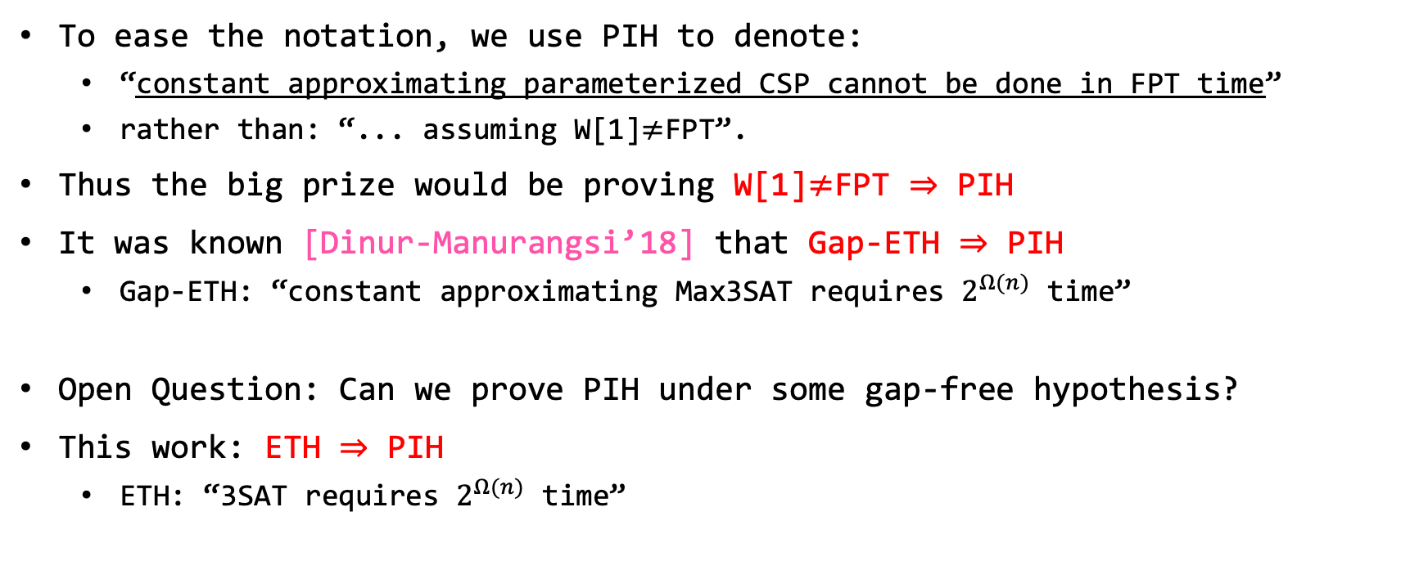
Parameterized Inapproximability Hypothesis
To ease the notation, we use PIH to denote:
  “constant approximating parameterized CSP cannot be done in FPT time”
  rather than: “... assuming W[1]$≠$FPT”.
Thus the big prize would be proving W[1]$≠$FPT $⇒$ PIH
It was known [Dinur-Manurangsi’18] that Gap-ETH $⇒$ PIH
  Gap-ETH: “constant approximating Max3SAT requires $2^{Ω(n)}$ time”
Open Question: Can we prove PIH under some gap-free hypothesis?
This work: ETH $⇒$ PIH
  ETH: “3SAT requires $2^{Ω(n)}$ time”
Notes:
Gap-ETH: inherent gap in it, gap-preserving much easier …
first successful attempt to …

Slide 12
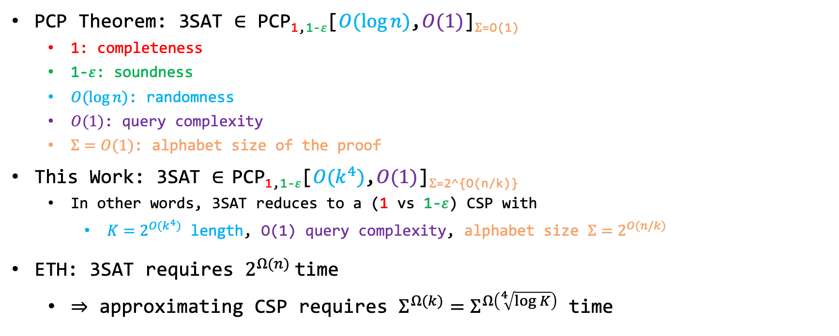

ETH $⇒$ PIH
PCP Theorem: 3SAT $∈$ PCP_{1,1-}$ε$[$O(log⁡n)$,$O(1)$]$Σ$_{=O(1)}
  1: completeness
  1-$ε$: soundness
  $O(log⁡n)$: randomness
  $O(1)$: query complexity
  $Σ=O(1)$: alphabet size of the proof
This Work: 3SAT $∈$ PCP_{1,1-}$ε$[$O(k^{4})$,$O(1)$]$Σ$_{=2^{O(n/k)}}
  In other words, 3SAT reduces to a (1 vs 1-$ε$) CSP with
    $K=2^{O(k^{4})}$ length, O(1) query complexity, alphabet size ${Σ=2}^{O(n/k)}$
ETH: 3SAT requires $2^{Ω(n)}$time
  $⇒$ approximating CSP requires $Σ^{Ω(k)}=Σ^{Ω\left(\sqrt[4]{\log{K}}\right)}$ time

Slide 13
Proof Sketch
1. Reduce 3SAT to Vector-Valued CSP (VecCSP)
  VecCSP: an intermediate vectorized problem, where the constraints are divided into a parallel part and a linear part
2. Design Parallel PCP of Proximity for both parts
  used Hadamard Code based PCPP [Arora-Lund-Motwani-Sudan-Szegedy’98] due to its simplicity and ease of parallelization
  but a wide range of PCPPs could work, too

Slide 14
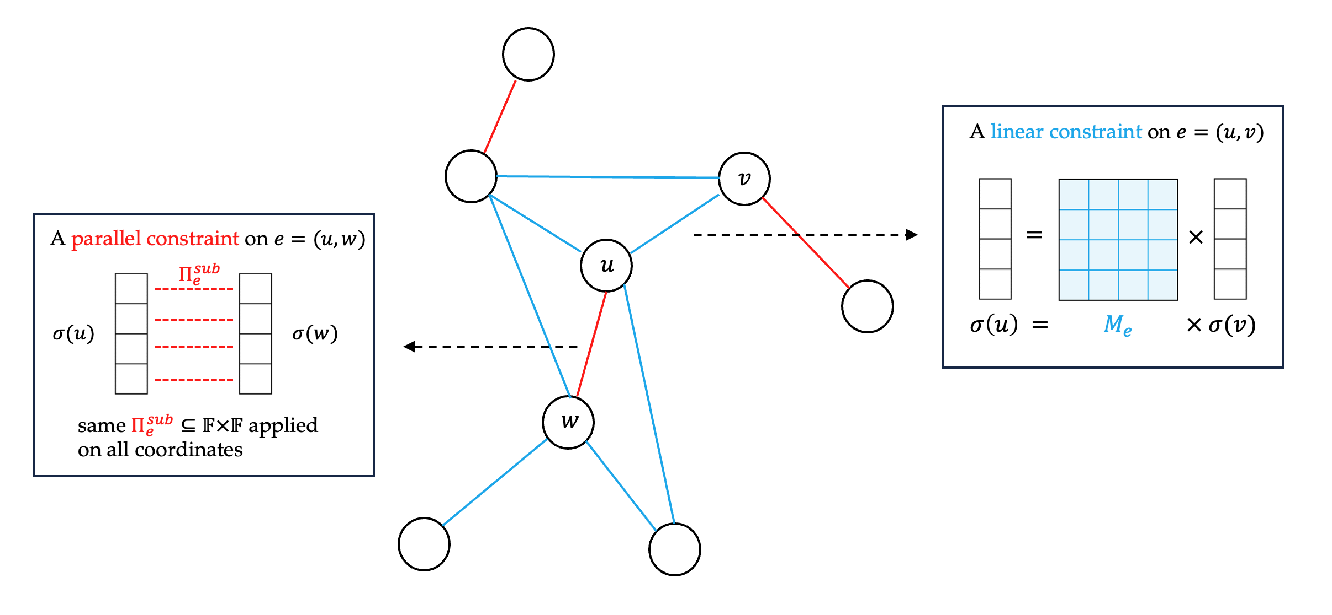

Vector-Valued CSP
A CSP instance $Γ=\left(X,Σ,Φ\right)$, where
  $Σ=𝔽^{d}$ - alphabet: $d$-dimensional vectors over a finite field $𝔽$.
  Each constraint $Π_{e}(u,w)$ on $u=(u_{1},…,u_{d})$ and $w=(w_{1},…,w_{d})$ is either
    Linear: there is a matrix $M_{e}∈$ $𝔽^{d×d}$ such that $Π_{e}\left(u,w\right)=1_{u=M_{e}w}$, or
    Parallel: there is a sub-constraint $Π_{e}^{sub}:𝔽×𝔽→\{0,1\}$, such that $Π_{e}(u,w)$ checks $Π_{e}^{sub}$ in parallel on all $d$ coordinates.

Slide 15
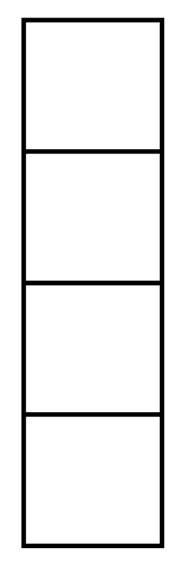
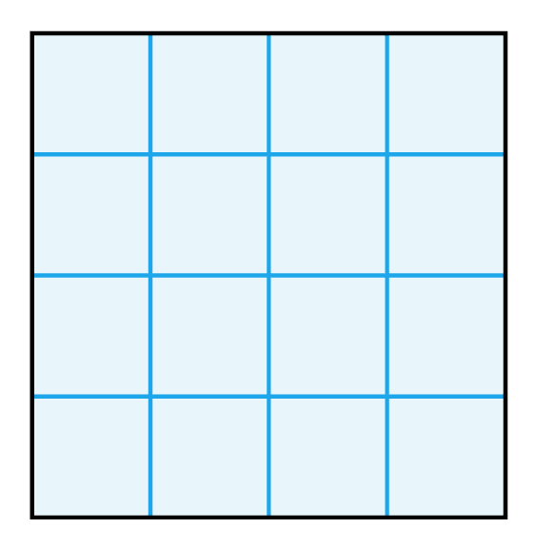


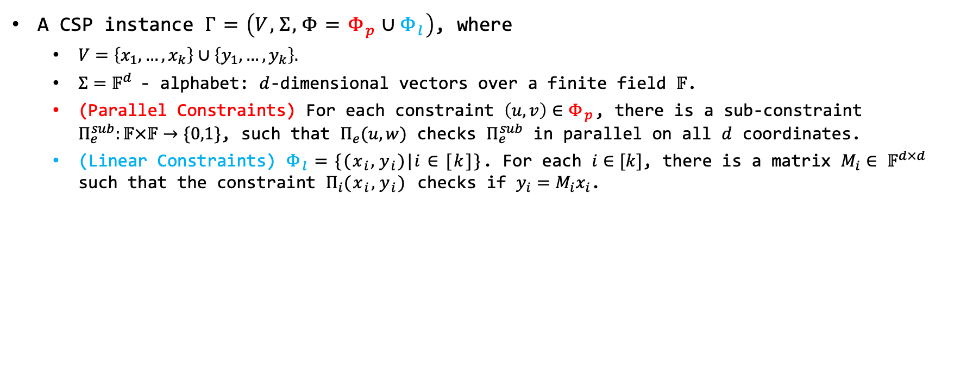







Vector-Valued CSP
A CSP instance $Γ=\left(V,Σ,Φ=Φ_{p}∪Φ_{l}\right)$, where
  $V=\left\{x_{1},…,x_{k}\right\}∪\left\{y_{1},…,y_{k}\right\}.$
  $Σ=𝔽^{d}$- alphabet: $d$-dimensional vectors over a finite field $𝔽$.
  (Parallel Constraints) For each constraint $\left(u,v\right)∈Φ_{p}$, there is a sub-constraint $Π_{e}^{sub}:𝔽×𝔽→\{0,1\}$, such that $Π_{e}(u,w)$ checks $Π_{e}^{sub}$ in parallel on all $d$ coordinates.
  (Linear Constraints) $Φ_{l}=\{(x_{i},y_{i})|i∈[k]\}$. For each $i∈[k]$, there is a matrix $M_{i}∈$ $𝔽^{d×d}$ such that the constraint $Π_{i}(x_{i},y_{i})$ checks if $y_{i}=M_{i}x_{i}$.
A parallel constraint on $e=(u,w)$
A linear constraint on $e=(x_{i},y_{i})$
$$Π_{e}^{sub}$$
$$σ(u)$$
$$σ(w)$$
$$=$$
$$×$$
$$Π_{e}^{sub}$$
same $Π_{e}^{sub}⊆𝔽×𝔽$ applied on a subset of coordinates
$σ\left(y_{i}\right) = M_{e}$ $× σ(x_{i})$
Notes:
This is in fact the definition of Special VecCSP

Slide 16


3SAT$→$VecCSP
3SAT $→$3-Coloring $→$VecCSP
Lemma (folklore): 3SAT is reducible to 3-Coloring, with a linear blow-up ($\left|G\right|=O(|φ|)$).

Slide 17


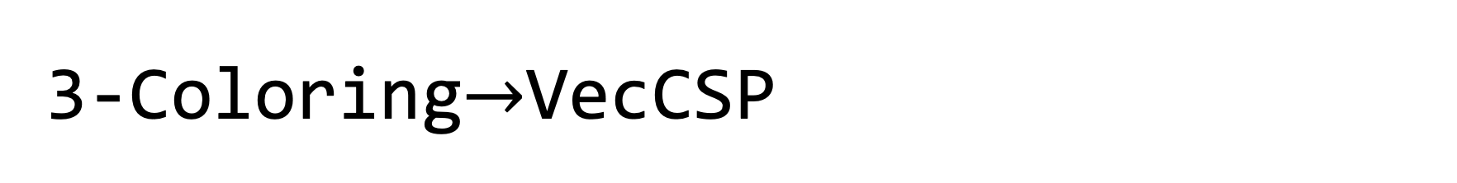






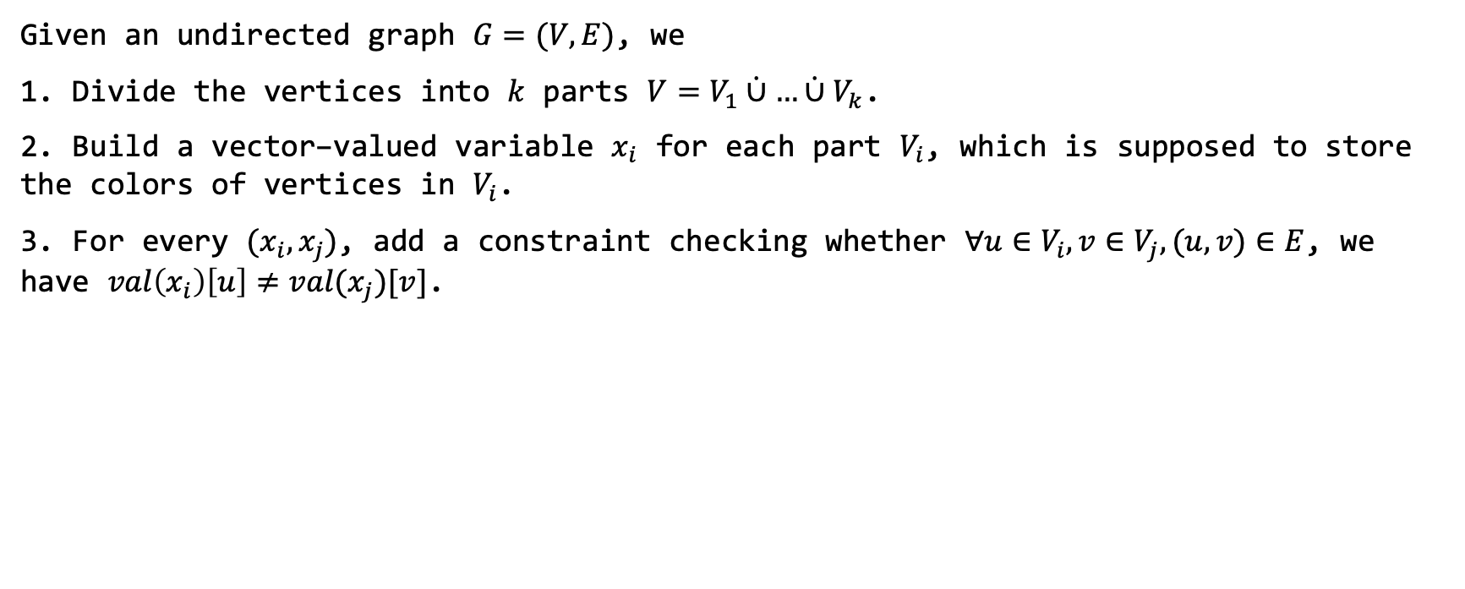


3-Coloring$→$VecCSP
Given an undirected graph $G=(V,E)$, we
1. Divide the vertices into $k$ parts $V=V_{1}\dot{∪}…\dot{∪}V_{k}$.
2. Build a ${\text{vector}\text{−}\text{valued} \text{variable} x_{i} \text{for} \text{each} \text{part} V}_{i}$, which is supposed to store the colors of vertices in $V_{i}$.
3. For every $(x_{i},x_{j})$, add a constraint checking whether $∀u∈V_{i},v∈V_{j},(u,v)∈E$, we have $val\left(x_{i}\right)\left[u\right]≠val(x_{j})[v]$.
$$z_{1}$$
$$z_{2}$$
$$z_{3}$$
$$z_{4}$$
$$z_{5}$$
$$z_{6}$$
$$z_{1}$$
$$z_{3}$$
$$z_{4}$$
$$z_{2}$$
$$z_{5}$$
$$z_{6}$$
$$x_{1}$$
$$x_{2}$$
Notes:
For simplicity, the example here is not 4-regular

Slide 18


3-Coloring$→$VecCSP
Given an undirected graph $G=(V,E)$, we
1. Divide the vertices into $k$ parts $V=V_{1}\dot{∪}…\dot{∪}V_{k}$.
2. Build a ${\text{vector}\text{−}\text{valued} \text{variable} x_{i} \text{for} \text{each} \text{part} V}_{i}$, which is supposed to store the colors of vertices in $V_{i}$.
3. For every $(x_{i},x_{j})$, add a constraint checking whether $∀u∈V_{i},v∈V_{j},(u,v)∈E$, we have $val\left(x_{i}\right)\left[u\right]≠val(x_{j})[v]$.
$$z_{1}$$
$$z_{2}$$
$$z_{3}$$
$$z_{4}$$
$$z_{5}$$
$$z_{6}$$
$$z_{1}$$
$$z_{3}$$
$$z_{4}$$
$$z_{2}$$
$$z_{5}$$
$$z_{6}$$
$$x_{1}$$
$$x_{2}$$

Slide 19





















3-Coloring$→$VecCSP
4. Make many copies of each variable, and split the constraints onto different copies, such that
  each copy is adjacent to only one constraint
  the only constraint is a (partial) matching on the $d×d$ entries
$$z_{1}$$
$$z_{2}$$
$$z_{3}$$
$$z_{4}$$
$$z_{5}$$
$$z_{6}$$
$$z_{1}$$
$$z_{2}$$
$$z_{3}$$
$$z_{4}$$
$$z_{5}$$
$$z_{6}$$
$$z_{1}$$
$$z_{2}$$
$$z_{3}$$
$$z_{4}$$
$$z_{5}$$
$$z_{6}$$
$$z_{1}$$
$$z_{2}$$
$$z_{3}$$
$$z_{1}$$
$$z_{2}$$
$$z_{3}$$
$$z_{4}$$
$$z_{5}$$
$$z_{6}$$
$$z_{4}$$
$$z_{5}$$
$$z_{6}$$
$$x_{1}$$
$$x_{2}$$
$$x_{1}^{1}$$
$$x_{2}^{1}$$
$$x_{1}^{2}$$
$$x_{2}^{2}$$
$$x_{1}^{3}$$
$$x_{1}^{4}$$
$$x_{2}^{3}$$
$$x_{2}^{4}$$

Slide 20
















3-Coloring$→$VecCSP
5. Then, permute the $d$ coordinates of each variable according to its only constraint, such that the constraints are all parallel.
6. We also need to check the consistency between different copies, which is a permuted equality, and can be done by linear constraints.
$$z_{1}$$
$$z_{2}$$
$$z_{3}$$
$$z_{5}$$
$$z_{6}$$
$$z_{4}$$
$$z_{1}$$
$$z_{2}$$
$$z_{3}$$
$$z_{6}$$
$$z_{5}$$
$$z_{4}$$
$$z_{1}$$
$$z_{2}$$
$$z_{3}$$
$$z_{3}$$
$$z_{1}$$
$$z_{2}$$
$$z_{4}$$
$$z_{5}$$
$$z_{6}$$
$$z_{6}$$
$$z_{4}$$
$$z_{5}$$
$$x_{1}^{1}$$
$$x_{2}^{1}$$
$$x_{1}^{2}$$
$$x_{2}^{2}$$
$$x_{1}^{3}$$
$$x_{1}^{4}$$
$$x_{2}^{3}$$
$$x_{2}^{4}$$

Slide 21









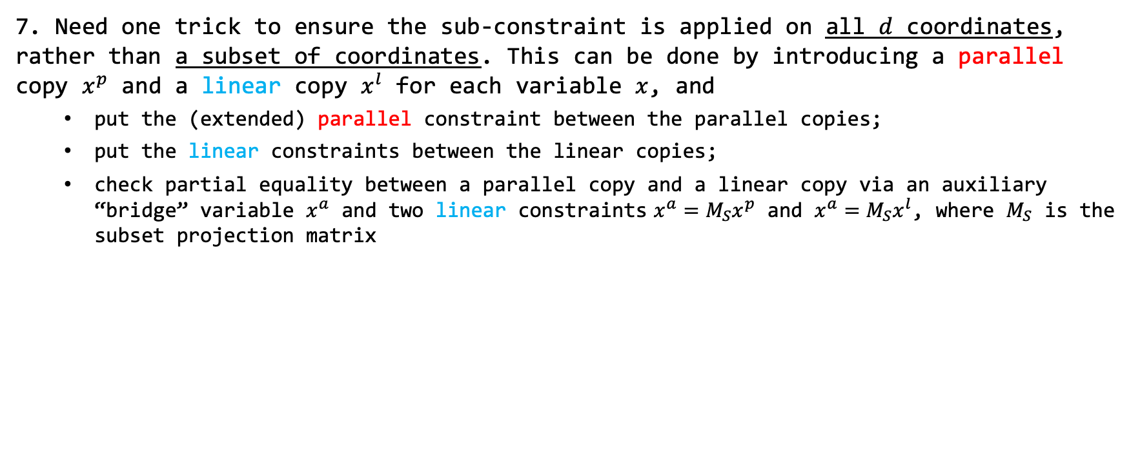

3-Coloring$→$VecCSP
7. Need one trick to ensure the sub-constraint is applied on all $d$ coordinates, rather than a subset of coordinates. This can be done by introducing a parallel copy $x^{p}$ and a linear copy $x^{l}$ for each variable $x$, and
  put the (extended) parallel constraint between the parallel copies;
  put the linear constraints between the linear copies;
  check partial equality between a parallel copy and a linear copy via an auxiliary “bridge” variable $x^{a}$ and two linear constraints $x^{a}=M_{S}x^{p}$ and $x^{a}=M_{S}x^{l}$, where $M_{S}$ is the subset projection matrix
$$x^{p}$$
$$y^{p}$$
$$z^{p}$$
$$G$$
$$x$$
$$y$$
$$z$$
$$G′$$
$$x^{a}$$
$$y^{a}$$
$$z^{a}$$
$$x^{l}$$
$$y^{l}$$
$$z^{l}$$
: a parallel constraint, on a subset of coordinates
: a parallel constraint on all coordinates
: a linear constraint, the arrow shows the direction
: a linear constraint which computes the projection

Slide 22









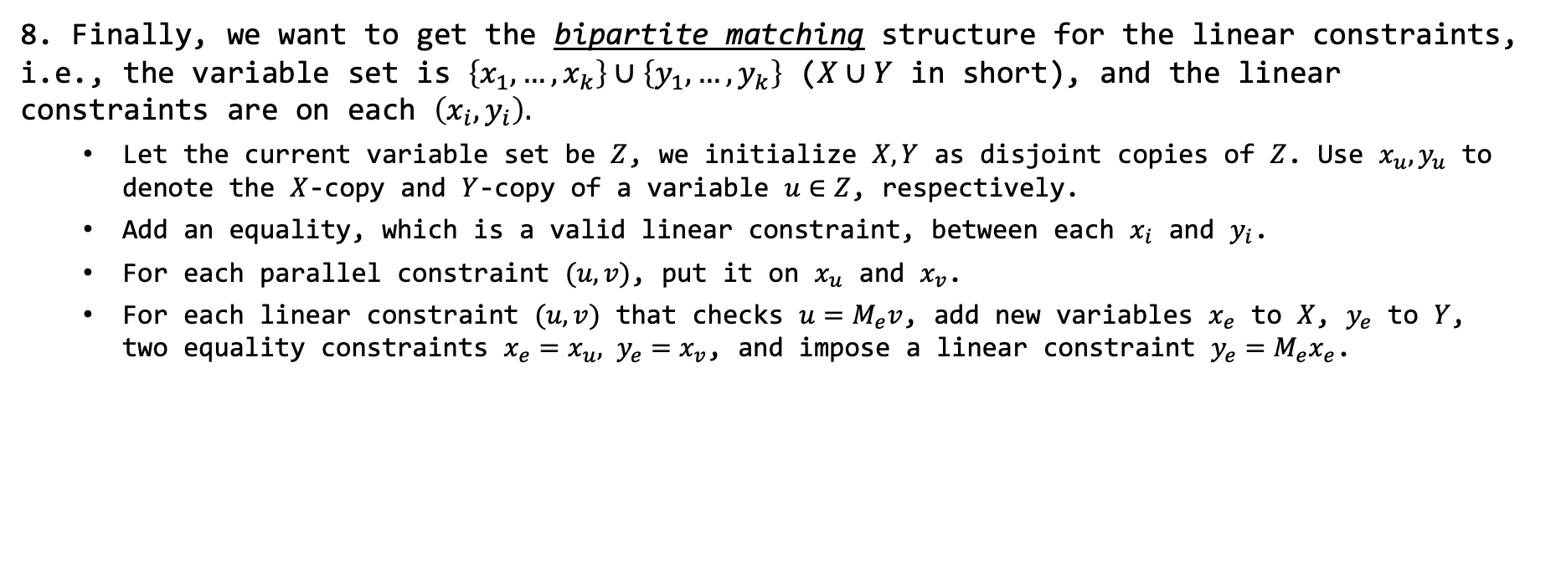



3-Coloring$→$VecCSP
8. Finally, we want to get the bipartite matching structure for the linear constraints, i.e., the variable set is $\left\{x_{1},…,x_{k}\right\}∪\left\{y_{1},…,y_{k}\right\}$ ($X∪Y$ in short), and the linear constraints are on each $\left(x_{i},y_{i}\right).$
  Let the current variable set be $Z$, we initialize $X,Y$ as disjoint copies of $Z$. Use $x_{u},y_{u}$ to denote the $X$-copy and $Y$-copy of a variable $u∈Z$, respectively.
  Add an equality, which is a valid linear constraint, between each $x_{i}$ and $y_{i}$.
  For each parallel constraint $(u,v)$, put it on $x_{u}$ and $x_{v}$.
  For each linear constraint $(u,v)$ that checks $u=M_{e}v$, add new variables $x_{e}$ to $X$, $y_{e}$ to $Y$, two equality constraints $x_{e}=x_{u}, y_{e}=x_{v}$, and impose a linear constraint $y_{e}=M_{e}x_{e}$.
$$x_{e_{2}}$$
$$x_{u}$$
$$x_{v}$$
$$x_{w}$$
$$G′$$
$$u$$
$$v$$
$$e_{2}$$
$$w$$
$$G′′$$
$$e_{1}$$
$$y_{e_{2}}$$
$$y_{u}$$
$$y_{v}$$
$$y_{w}$$
: a linear constraint checking equality
: a parallel constraint checking equality

Slide 23
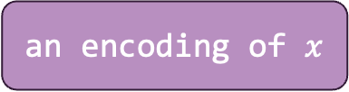

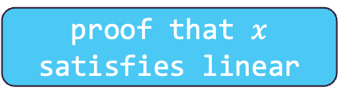
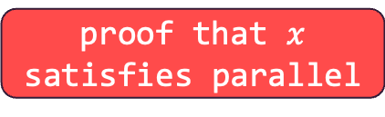
PCP of Proximity
Suppose Alice wants to convince you that a VecCSP instance is satisfiable.
She could give you a proof that the parallel part is satisfiable, and a proof that the linear part is satisfiable.
Wait! How to ensure the two parts share the same solution?
We need PCP of proximity! The statement to prove is not “$Γ$ is satisfiable”, but “$x$ is (the encoding of) a solution to $Γ$”!
final proof:
an encoding of $x$
proof that $x$ satisfies parallel
proof that $x$ satisfies linear

Slide 24
PCP of Proximity
Suppose Alice wants to convince you that a VecCSP instance is satisfiable.
She could give you a proof that the parallel part is satisfiable, and a proof that the linear part is satisfiable.
Wait! How to ensure the two parts share the same solution?
We need PCP of proximity! The statement to prove is not “$Γ$ is satisfiable”, but “$x$ is (the encoding of) a solution to $Γ$”!
PCPP verifier for linear
final proof:
an encoding of $x$
proof that $x$ satisfies parallel
proof that $x$ satisfies linear
PCPP verifier for parallel

Slide 25
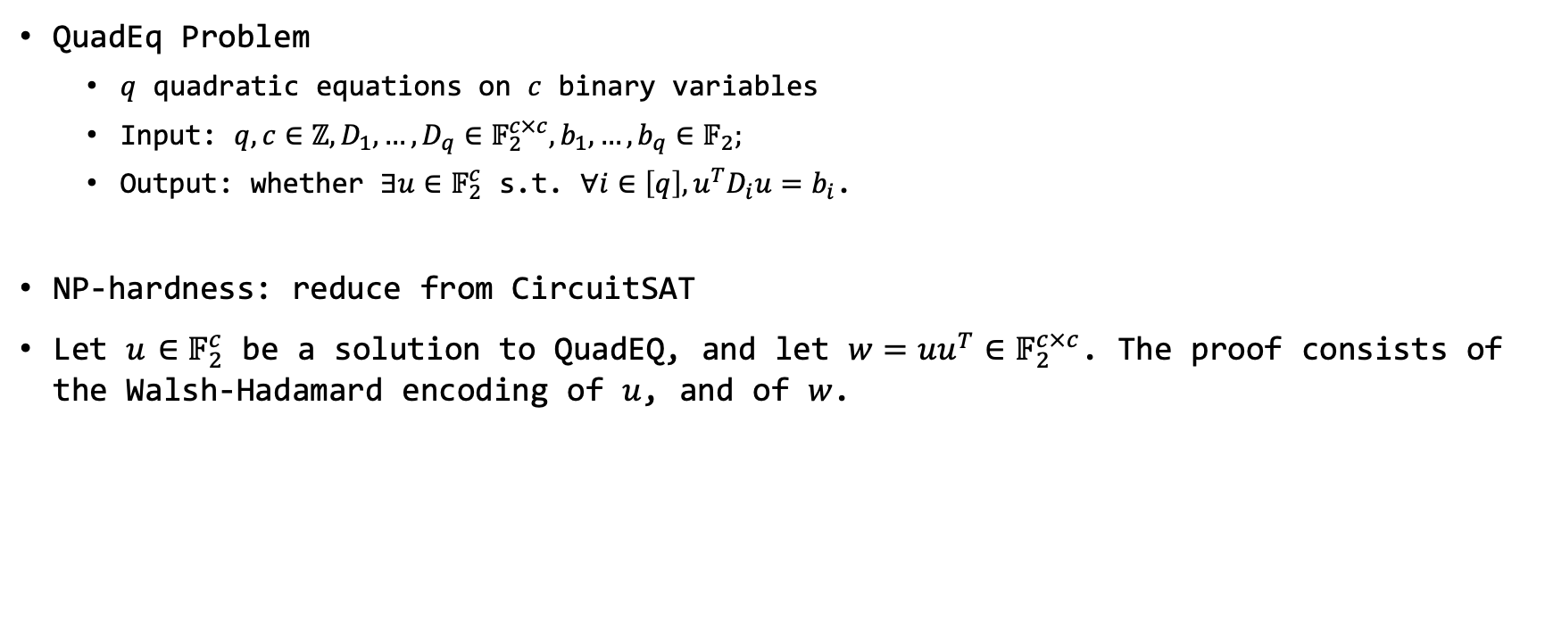




Hadamard Code Based PCPP
QuadEq Problem
  $q$ quadratic equations on $c$ binary variables
  Input: $q,c∈ℤ,D_{1},…,D_{q}∈𝔽_{2}^{c×c},b_{1},…,b_{q}∈𝔽_{2};$
  Output: whether $∃u∈𝔽_{2}^{c}$ s.t. $∀i∈\left[q\right], u^{T}D_{i}u=b_{i}$.
NP-hardness: reduce from CircuitSAT
Let $u$ $∈𝔽_{2}^{c}$ be a solution to QuadEQ, and let $w=uu^{T}$ $∈𝔽_{2}^{c×c}$. The proof consists of the Walsh-Hadamard encoding of $u$, and of $w$.
WH($u$)
WH($w$)
$$2^{c}$$
$$2^{c^{2}}$$

Slide 26


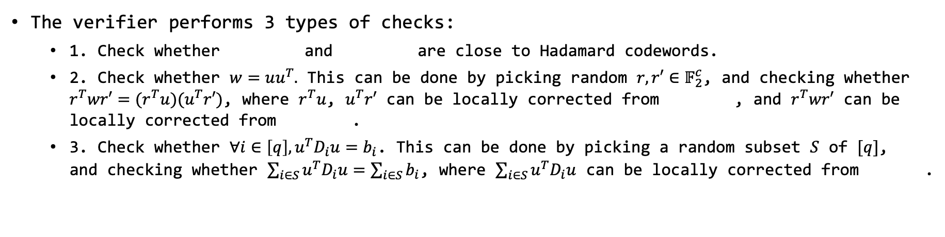

Hadamard Code Based PCPP
QuadEq Problem
  $q$ quadratic equations on $c$ binary variables
  Input: $q,c∈ℤ,D_{1},…,D_{q}∈𝔽_{2}^{c×c},b_{1},…,b_{q}∈𝔽_{2};$
  Output: whether $∃u∈𝔽_{2}^{c}$ s.t. $∀i∈\left[q\right], u^{T}D_{i}u=b_{i}$.
WH($u$)
WH($w$)
The verifier performs 3 types of checks:
  1. Check whether and are close to Hadamard codewords.
  2. Check whether $w=uu^{T}.$ This can be done by picking random $r,r′∈𝔽_{2}^{c}$, and checking whether $r^{T}wr′=(r^{T}u)(u^{T}r′)$, where $r^{T}u$, $u^{T}r′$ can be locally corrected from , and $r^{T}wr′$ can be locally corrected from .
  3. Check whether $∀i∈\left[q\right], u^{T}D_{i}u=b_{i}$. This can be done by picking a random subset $S$ of $[q]$, and checking whether $\sum_{i∈S}{u^{T}D_{i}u}=\sum_{i∈S}{b_{i}}$, where $\sum_{i∈S}{u^{T}D_{i}u}$ can be locally corrected from .

Slide 27

















PCPP for the Parallel Part
$$x_{1}$$
$$x_{2}$$
$$x_{k}$$
$$x^{1}≜$$
WH($x^{1}$)
WH($x^{1}{\left(x^{1}\right)}^{T}$)
$$…$$
$$…$$
the same circuit!
$$…$$
$$…$$
$$x^{d}≜$$
WH($x^{d}$)
WH($x^{d}{\left(x^{d}\right)}^{T}$)
$$∈$$
$$∈$$
$$∈$$
$$𝔽^{d}$$
$$𝔽^{d}$$
$$𝔽^{d}$$
Notes:
same randomness for each row

Slide 28

PCPP for the Parallel Part
$$x_{1}$$
$$x_{2}$$
$$x_{k}$$
$$x^{1}≜$$
WH($x^{1}$)
WH($x^{1}{\left(x^{1}\right)}^{T}$)
$$…$$
$$…$$
the same circuit!
$$…$$
$$…$$
$$x^{d}≜$$
WH($x^{d}$)
WH($x^{d}{\left(x^{d}\right)}^{T}$)
$$∈$$
$$∈$$
$$∈$$
$$𝔽^{d}$$
$$𝔽^{d}$$
$$𝔽^{d}$$
PCPP verifier

Slide 29
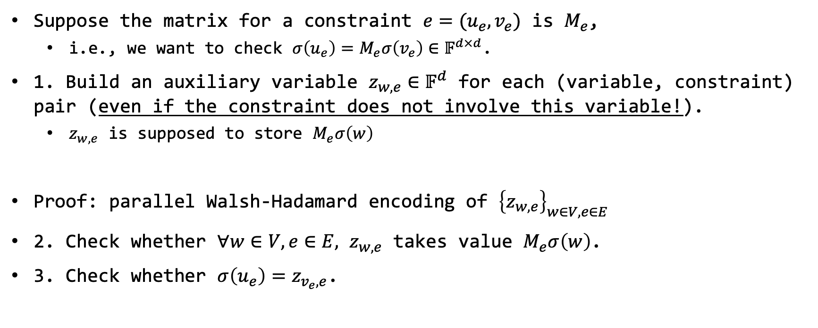
PCPP for the Linear Part
Suppose the matrix for a constraint $e=(u_{e}, v_{e})$ is $M_{e}$,
  i.e., we want to check $σ\left(u_{e}\right)=M_{e}σ\left(v_{e}\right)∈𝔽^{d×d}$.
1. Build an auxiliary variable $z_{w,e}∈𝔽^{d}$ for each (variable, constraint) pair (even if the constraint does not involve this variable!).
  $z_{w,e}$ is supposed to store $M_{e}σ\left(w\right)$
Proof: parallel Walsh-Hadamard encoding of ${\left\{z_{w,e}\right\}}_{w∈V,e∈E}$
2. Check whether $∀w∈V,e∈E,$ $z_{w,e}$ takes value $M_{e}σ\left(w\right)$.
3. Check whether ${σ\left(u_{e}\right)=z}_{v_{e},e}$.

Slide 30






Combine Things Together
3SAT$→$VecCSP(parallel part, linear part)[$𝔽=O\left(1\right),d=O(n/k)$]
VecCSP $∈$ PCP_{1,1-}$ε$[$O(k^{4})$,$O(1)$]$Σ$_{=2^{O(n/k)}}
PCPP verifier for linear
PWH($x$)
proof that $x$ satisfies parallel
proof that $x$ satisfies linear
$$d$$
final proof:
PCPP verifier for parallel
$$2^{O(k^{4})}$$

Slide 31
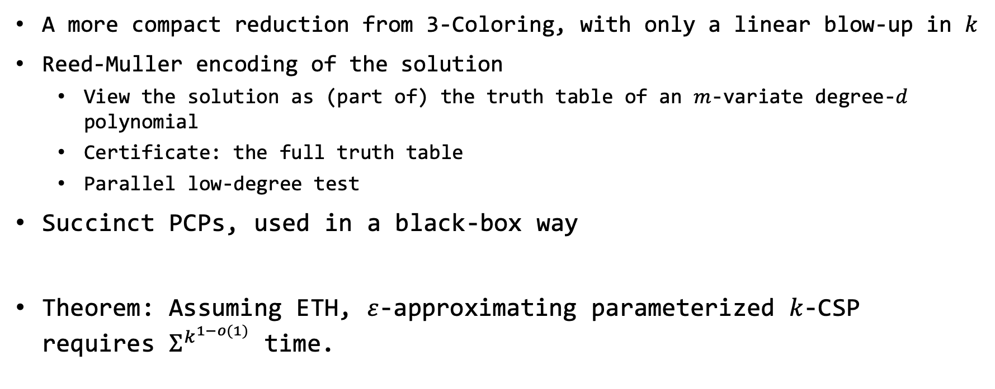
Recent Improvement
A more compact reduction from 3-Coloring, with only a linear blow-up in $k$
Reed-Muller encoding of the solution
  View the solution as (part of) the truth table of an $m$-variate degree-$d$ polynomial
  Certificate: the full truth table
  Parallel low-degree test
Succinct PCPs, used in a black-box way
Theorem: Assuming ETH, $ε$-approximating parameterized $k$-CSP requires $Σ^{k^{1−o(1)}}$ time.

Slide 32

Open Questions
Prove PIH under W[1]$≠$FPT?
  Obstacle: $k$-Clique, the W[1]-complete problem, may not be reducible to VecCSP
Thanks for listening!

